Slide 1
Capitalizing on Trends in Healthcare Transformation
Sue Owen
Principal, Healthcare Transformation Services, Philips Canada
Chair, National Board of Directors, Canadian College of Health Leaders

Slide 2
Before We Get to Trends….An Overview of Our (Very) Complex Current State

Slide 3
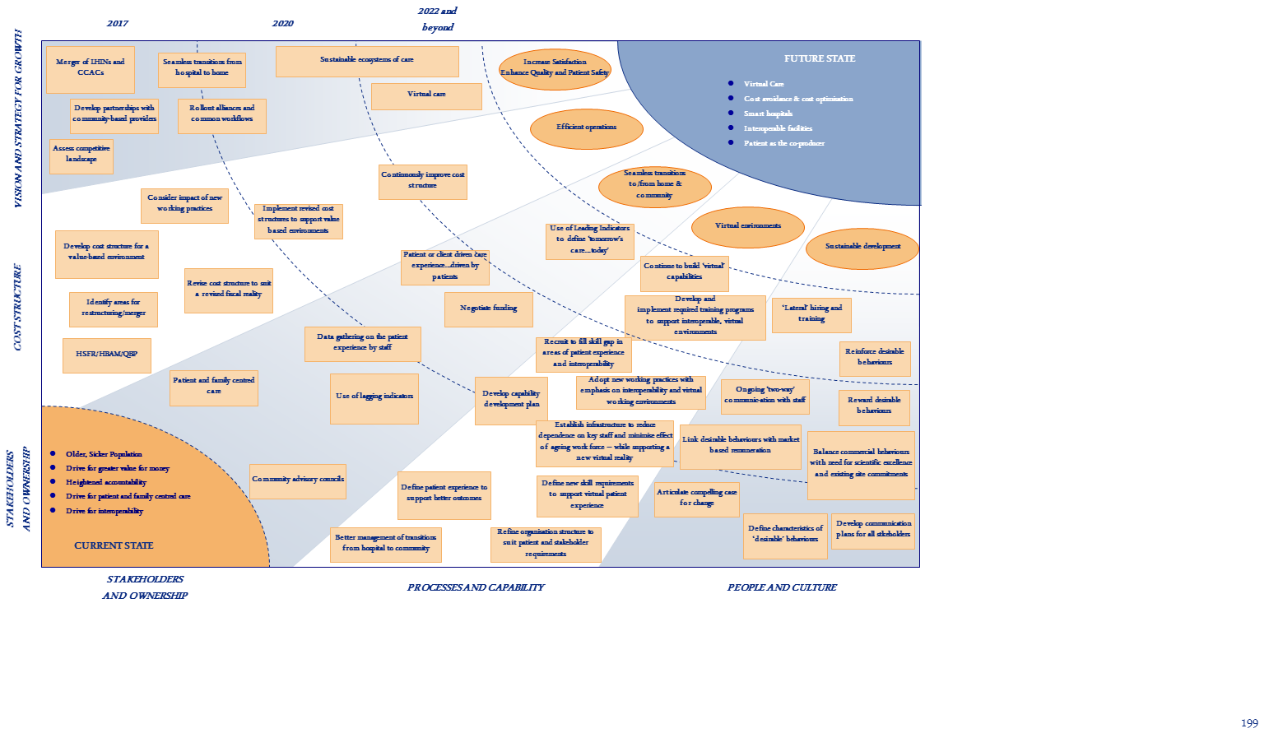

Slide 4
Economic Realities
Driving the Need for New Approaches in Healthcare
volume
value
Clinical and economic outcomes are driving provider reimbursement, compliance to standards of care and the ‘consumerization’ of health care
response
prevention
Move from treating illness to maintaining population wellness; resource allocation will shift to preventive care and reduction of complications and readmissions
episodic
continuous
Connecting information across the care ecosystem to enabling more appropriate, timely clinical intervention and decision-making
limited
accessible
Expanding access to care for all will include solving challenges related to affordability, remote access, and clinical talent

Slide 5
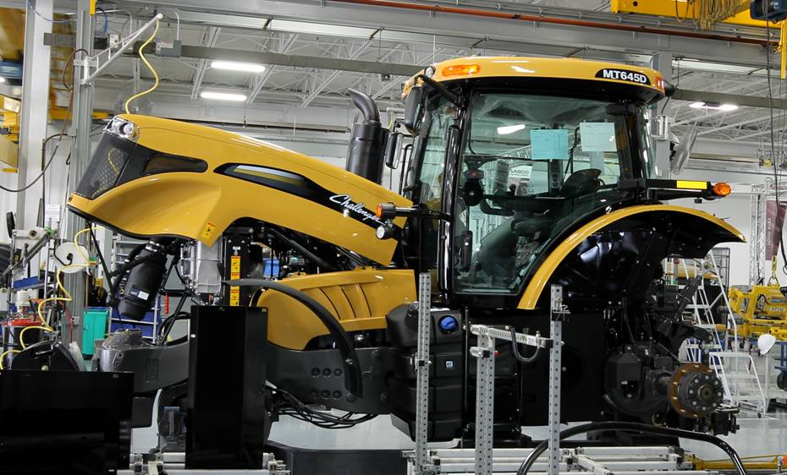
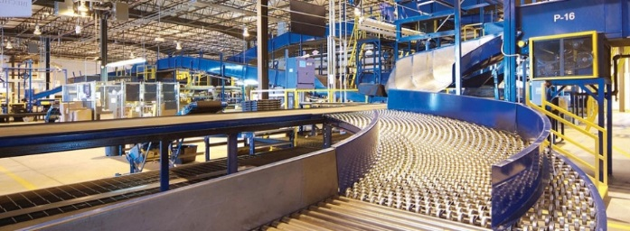
Inspiration Increasingly Coming from Other Industries
Big data & analytics
System integration
Structured + unstructured data
Machine learning
Advanced visualization
Process engineering
Lean/six sigma
Queuing theory
Location tracking
Visual control systems
Organizational design
Complex adaptive systems
Airlines control centers
Manufacturing
Distribution & logistics
Notes:
Using our people research methodologies and multi competence teams, we work with our partners to understand the current and future ecosystems across stakeholders to co-create the future.

Slide 6
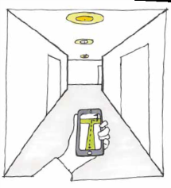
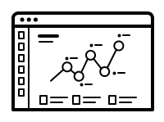
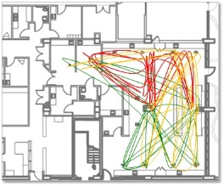
“Smart” Care Solutions are the New Normal
Integrated and
Automated
Logistics
Predictive Analytics
Real Time Clinical Decision Support
Remote Monitoring and Telehealth
Clinical Data Integration and Machine Learning
Image
Notes:
Using our people research methodologies and multi competence teams, we work with our partners to understand the current and future ecosystems across stakeholders to co-create the future.

Slide 7
So What Does This Mean? Part 1
Tools used to design our current state (system) are or will become obsolete
The environment will become the teacher
Ecosystems of care will be driven by patients
Continued blurring of lines between personal and ‘professional’ health care
We will need to get “Smarter” -- differently
Not about aesthetics – it’s about Designing from “the inside out”

Slide 8
So What Does This Mean? Part 2
Consider:
“Management” => “Leadership” => “Breakthrough Thinking”
Quantifiable Management => Emotional Response
Stand-alone facilities => Ecosystems of change
Impact on individual care => Impact on communities
Evolution away from ‘satisfaction’ or ‘engagement’ to agents of change

Slide 9
3 Potential Areas of Focus
Designing for smart hospitals
Application of Design Thinking into “everyday” activities
Social Movements as drivers of change

Slide 10
1. Smart Hospitals - Organizing Principles
Deliberate approach to integrated “smartness”
Interoperability
Automation
Technology enables ‘patients as the co-producer of care’
“Smart” Workflows
Mobility – particularly from Hospital to Home
High reliability
Connectivity through single device/real time tracking
Name badge as an interoperable tool
Fully integrated electronic health record
Strong risk management to support data privacy and integrity

Slide 11
Smart Hospitals - Buildings Designed for the Human Experience
“Smart Hospitals for the ‘People Business’
Intuitive Wayfinding
Compact Vertical Design
Use of Natural Light
Use of ‘scenic views’ as a caregiver
“Wellness” is part of the building texture
Planning for “tomorrow’s care today”….differently

Slide 12
Evolving the Human Experience Alongside the Physical
Current
Future
Reactive
Strategic
Lagging indicators
Leading indicators
Planning by staff informed by patient information
Planning with the patient at the centre
Focus on Role
Focus on Purpose

Slide 13
2. Application of Design Thinking
Application of Design Thinking into all aspects of health care…not just building design
“Traditional” Design
Bricks and Mortar
Quantifiable
Applied at specific points
“Traditional” methods of inquiry: surveys, interviews, etc
Design at the “Centre of the Enterprise”
Focus on User Experience
Emotional Response to environments
Use of Design “Artefacts” to explore, define and communicate
“Co-Create” the experience

Slide 14
Design Thinking – cont’d
Application of Design Thinking into all aspects of health care…not just building design
System
Experience
Physical
Ecosystem Change
Local Change

Slide 15
Design Thinking – cont’d
Application of Design Thinking into all aspects of health care…not just building design
System
Experience
Physical
Empathy Maps
Experience Maps
Prototypes
Ecosystem Change
Local Change

Slide 16
What are the advantages of this approach?
Starting with the end in mind
Designed “for” and “by” the patients
Design from patients’ true perspective vs staff interpretation of patient perspectives

Slide 17
Sample Empathy Map
Evolution away from aesthetic to emotional experience
What does the patient think and feel?
What does the patient hear?
What does the patient see?
What does the patient say and do?
What are the pains?
What are the gains?

Slide 18
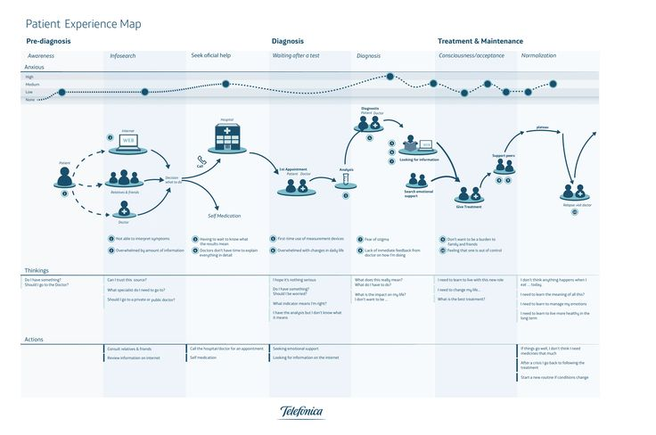
Sample Patient Experience Map
Source: Google images/pinterest.com

Slide 19
Application of Bridges to Health
Understanding the Total Needs of Patients and Families
160
800
140
700
120
Chronic conditions, normal function
600
100
500
80
Size of the population cohorts (in millions)
400
Frailty, with or without dementia
Cost of the Population (in Billion Dollars)
60
Acutely ill
Short period of decline before dying
300
40
200
Healthy
Stable with serious disability
Limited reserve & exacerbations
20
Maternal and
infant health
100
Adapted from the “Bridges to Health” model by Lynn J, et al
Notes:
Emotional about patients, not about ourselves!!

Slide 20
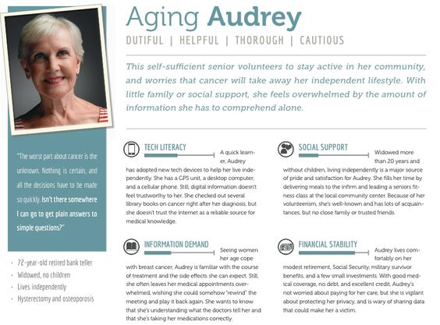
Example of Designing for Specific Personas
Aggregate persona – not actual patients based on summary information
Key aspects of persona – e.g. social support
Source: Google images/pinterest.com

Slide 21
How Can This Be Used? - Example
Mechanical Engineer
President & CEO of Engineering Firm
Weekend Warrior – broke spine in Sky-Diving Accident
Forced to retire and Marriage fell apart after accident
Has means for private in-home care, but is isolated and unable to care for himself
Tech-savvy – able to communicate
Friends visit but find his change in attitude uncomfortable
Children are 25 and 27 visit semi-regularly
Due to immobility has Kidney and Digestive challenges
Visits ED 1ce every 3 months for infection or phantom pain
Patient: Don, 53

Slide 22
Combined….
Powerful understanding of patient wants and needs
What does the patient think and feel?
Frustrated, useless, a burden – loss of desire to live – does not find joy in everyday things
What does the patient hear?
What does the patient see?
Talking about him “in the 3rd person”
“superficial” empathy
“everyone else enjoying life”
What does the patient say and do?
Angry, uncooperative, non-compliant
What are the pains?
What are the gains?
Low quality of life
Higher quality o f life

Slide 23
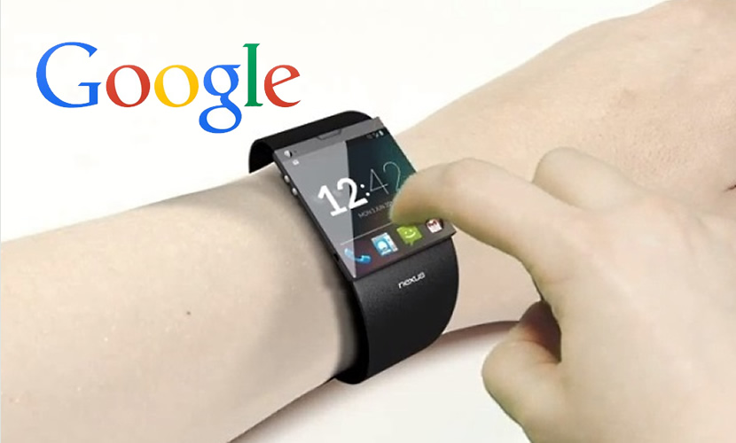
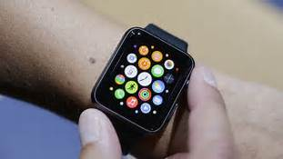
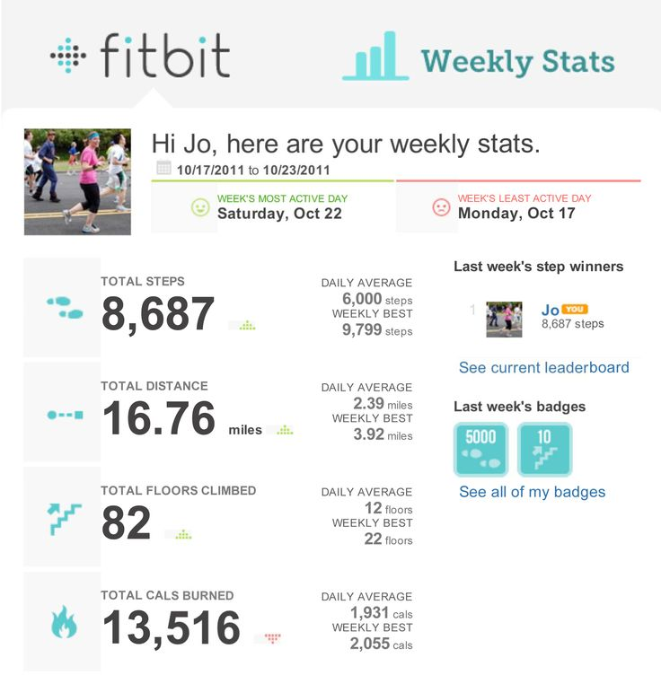
3. Intersection between Social Movements and Digital Health
(1) Wearables + (2) Social Movements + Transformation?
(1.) Wearables: Will your watch (or other wearable device) tell you when to go to the Doctor or Emergency Department?
Techcrunch May 2017: Apple Watch can detect abnormal heart rhythm with 97% accuracy
Techcrunch May 2017: Verily Study Watch devoted to serious medical studies like MS observation, Personalized Parkinson’s Project and contact lenses capable of monitoring wearers’ glucose level.

Slide 24
3. Intersection between Social Movements and Digital Health
(1) Wearables + (2) Social Movements + Transformation?
(2) Social Movements
Improvements rely on “top down” approach to service change and development – with numerous examples of success
Is what brought us here enough to take us to the next level? (and to support the notion that “change is changing”)
Large scale change relies not only on the top down/external drivers, but on the ability to connect with and mobilize “internal” energies and drivers for change - creating a “bottom up” locally-led “grass roots” movement for improvement and change

Slide 25
Intersection between Social Movements and Digital Health
“Orchestrated social movement” in the literature (Bate et al) when referring to organisational movements, suggesting that change is not managed as such but liberated, channelled, and enabled
To consider:
What are the characteristics of successful large scale mobilizing efforts?
Why do people join movements?
Why would people join a healthcare improvement movement as they might any other movement?
Who are the most important people for delivering radical changes to the quality of health care provided on the ground?
How to leverage the potential for change within an organization and apply social movements and potentially wearable devices? Consider the implications for both prevention and treatment
How to engage in a ‘liberating way’?.

Slide 26
Questions – and Thank you!

